Slide 1
Task 1: Data Analysis and Simple
Visualization in Excel
By
Miraj Ahmed
Corporate Analyst Development Program
(CADP)

Slide 2
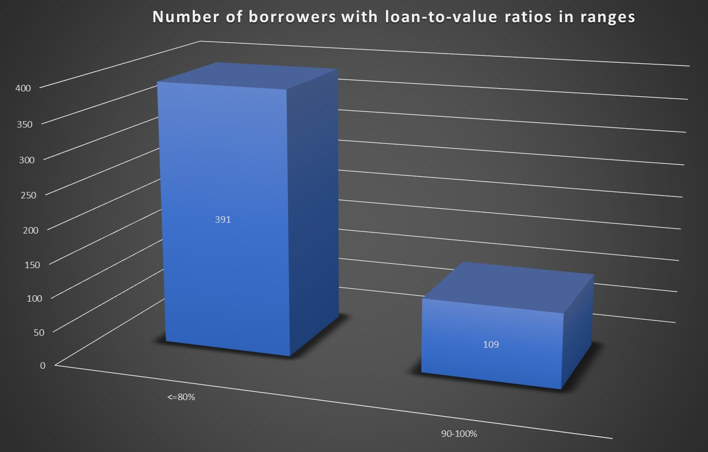
The large number of borrowers with loan-to- value ratios in a certain range, it may be an indication that there is a
high demand for mortgages within that range. This could present a potential sales opportunity for lenders
who can offer competitive interest rates and terms to attract these borrowers

Slide 3
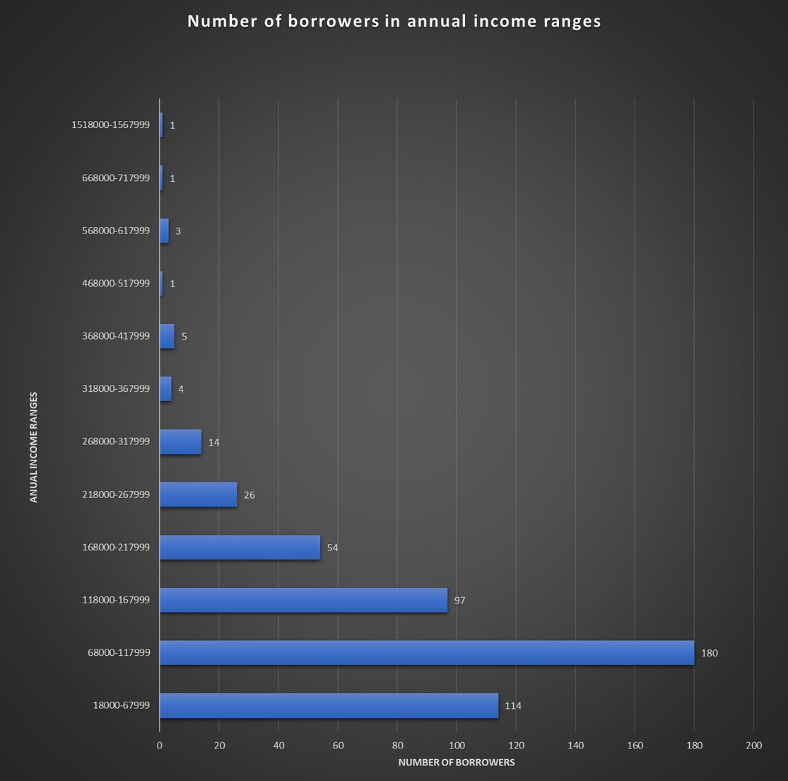
The analysis shows that a significant number of borrowers fall within the low-income range, lenders may consider offering more affordable loan products with lower interest rates and down payments to attract this customer segment.

Slide 4
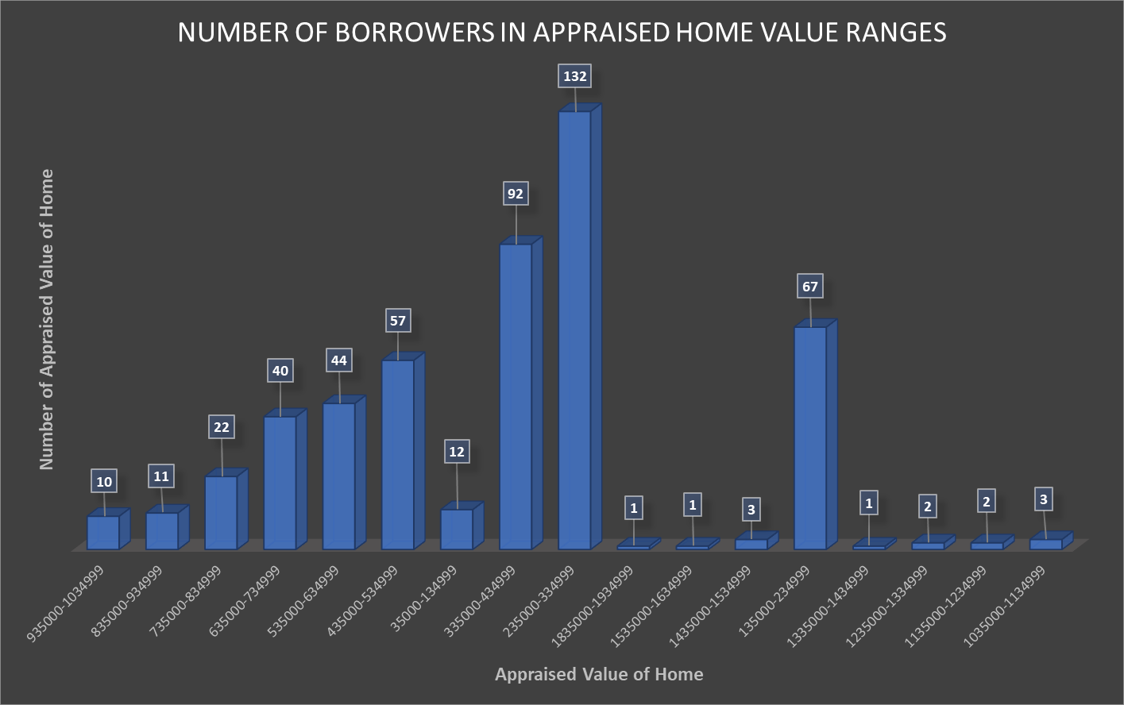
we can see that the highest number of borrowers fall within the appraised home value range of 335,000- 434,999, with a total of 92 borrowers in that range. The next highest range is 235,000- 334,999, with a total of 132 borrowers in that range. Therefore, targeting potential sales opportunities in the above mentioned ranges may yield higher results.

Slide 5
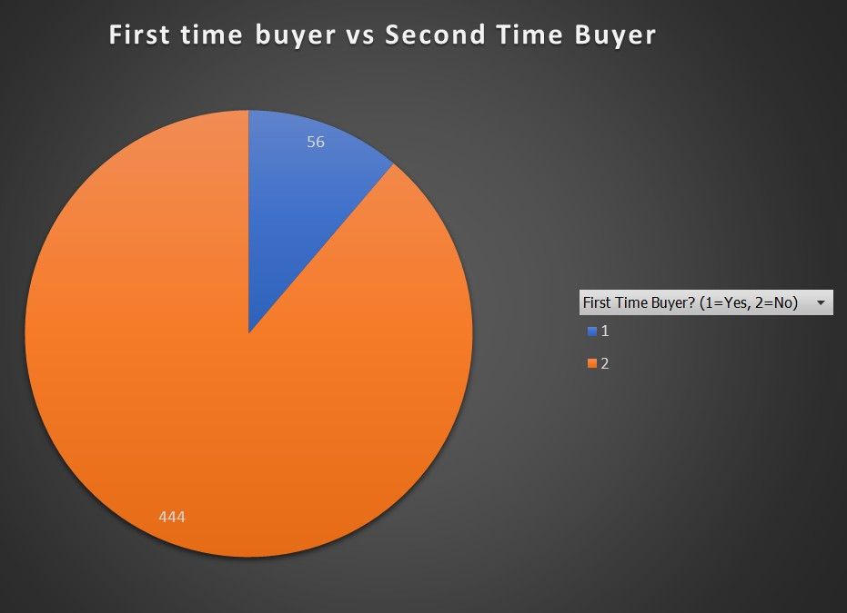
it appears that there are more second-time buyers than first-time buyers. This suggests that there may be a higher potential for sales opportunities with second-
time buyers.

Slide 6
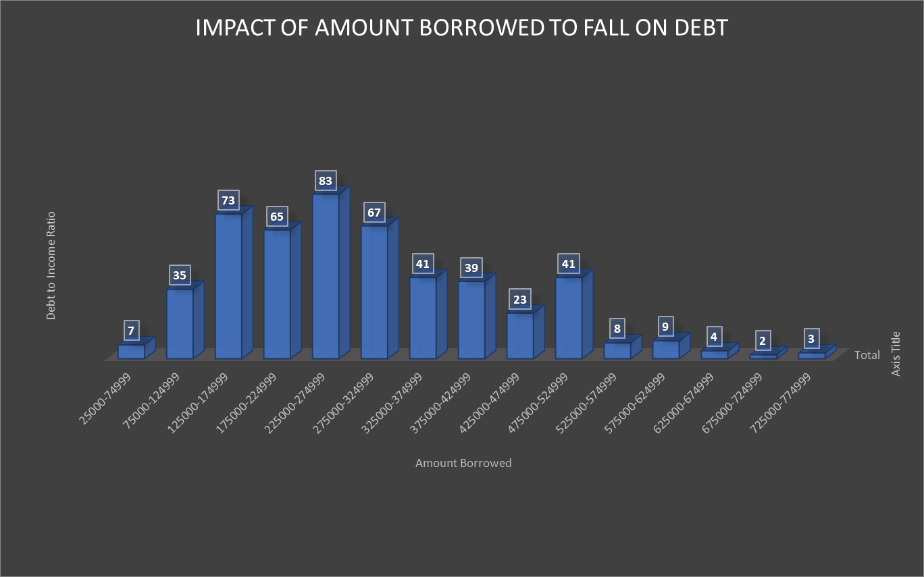

Slide 7
From the previous slide chart, suggests that there may be a potential sales opportunity for offering loan products with longer terms or lower interest rates to borrowers who have higher debt- to-income ratios.
It may also be worth targeting borrowers who fall into the higher amount borrowed ranges, as they tend to have higher debt-to- income ratios and may benefit from such loan products.
However, caution should be exercised to ensure that borrowers are not taking on more debt than they can handle, as this could lead to defaults and other negative outcomes for both the borrower and the lender.

